Slide 1

DSA210 term project
Utku Topal
32311

Slide 2
Motivation of The Project
As someone who has been using YouTube since it was first introduced in our country, I wanted to choose YouTube data as the dataset for this project. In addition to countless types of content, YouTube also provides access to a vast amount of academic material. Personally, I enjoy watching many lecture videos and educational content on YouTube, and I find it quite beneficial. Besides that, of course, I also watch series, matches, and movies on the platform.
As I watched a lot of academic videos to study for my exams in my university. I wanted to analyzse that does the exam periods have an effect on the videos that i watch on Youtube (eg. does it affect the categories of videos that i watch every day)
In conclusion, I can say that I wanted to examine whether the number and categories of videos I watch change during exam periods and whether there is a correlation between exams and the change in the categories of videos I watch, or if it is just a random occurrence.

Slide 3


THE STEPS OF MY PROJECT
The main objective of this project was to examine the relevance of YouTube video categories during exam periods. There were 5 main steps;
1- Data Gathering From Youtube
2- Visualizing the Data
3- Video Categorization
4- Exam Impact Analysis
5- Hypothesis Testing To Proof

Slide 4

Gathering The Data / Data Source
To get my Youtube Watch History Data I pressed the ‘Download My Data’ button and in Youtube and downloaded the data in the .json format which made my job easier to analyze and see my data.
At the slide five you can see how .json data looks like.

Slide 5

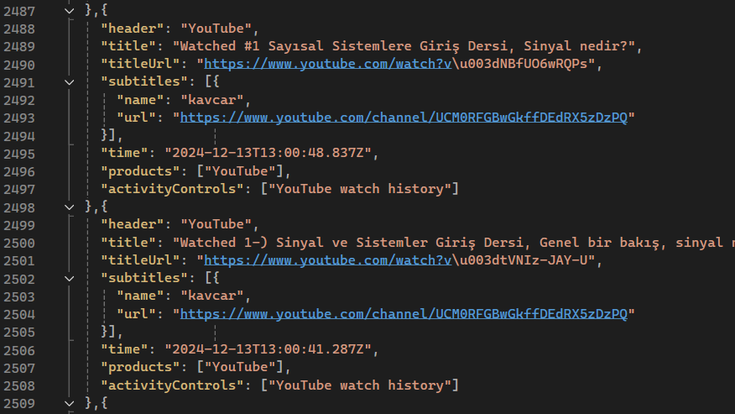




Slide 6
Techniques Used To Visualize The Data
1- EDA Techniques.
2- Data Visualization techniques such as bar charts and pie charts mostly used in my Project. And some visualization of tables about my exam dates.
3- Hyphothesis Testing is used to end up with a relevant claim.

Slide 7

Data Analysis/ Visualizing The Data
I created multiple graphs to show the number of videos watched each day starting from 25th of November to 9th of January.
I divided all the data into 4 main graphs;
1- Data from 25th of November to 30th of November
2- Data from 1st of December to 15th of December
3- Data from 16th of December to 31st of December
4- Data from 1st of January to 9th of January

Slide 8
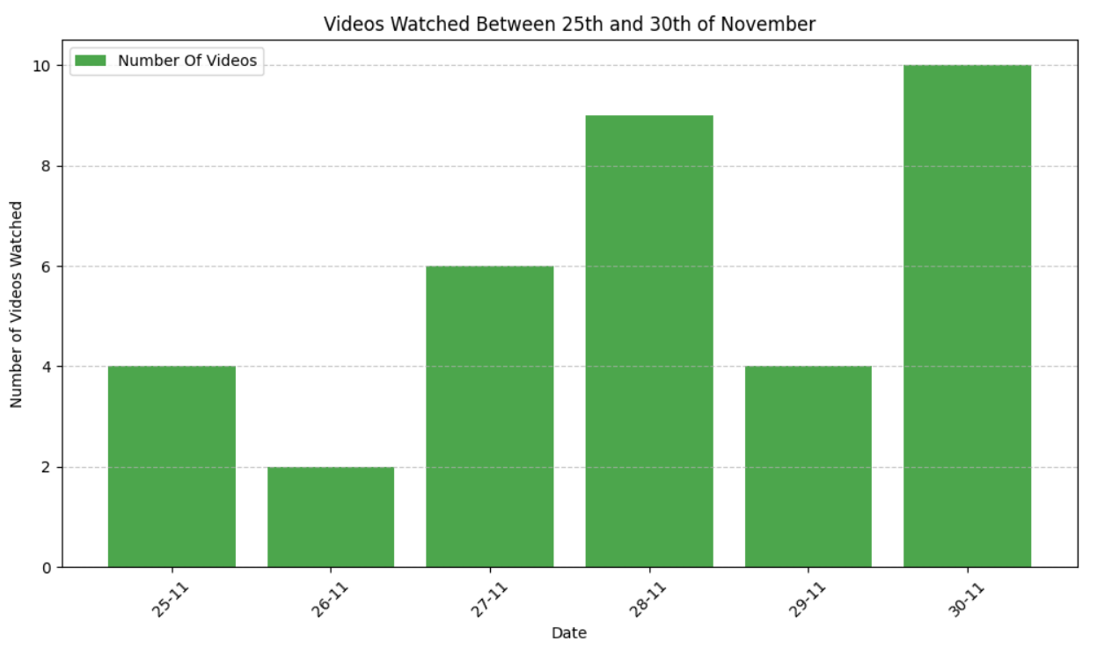
This is the first graph which is between 25th and 30th of November

Slide 9
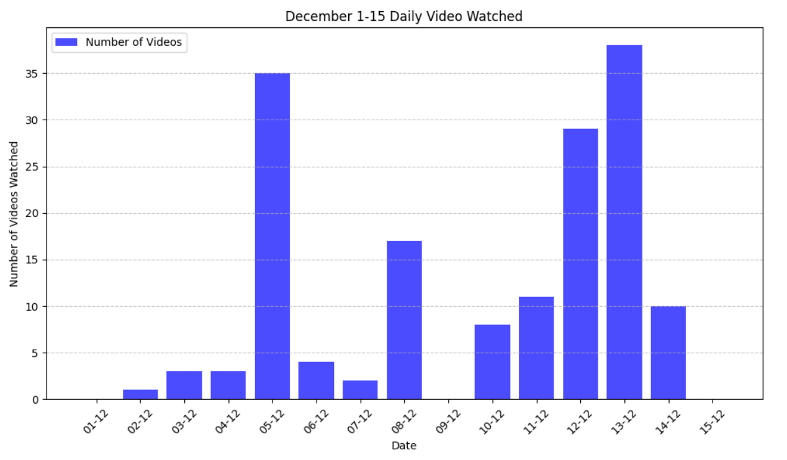
This is the second graph which is between 1st and 15th of December

Slide 10
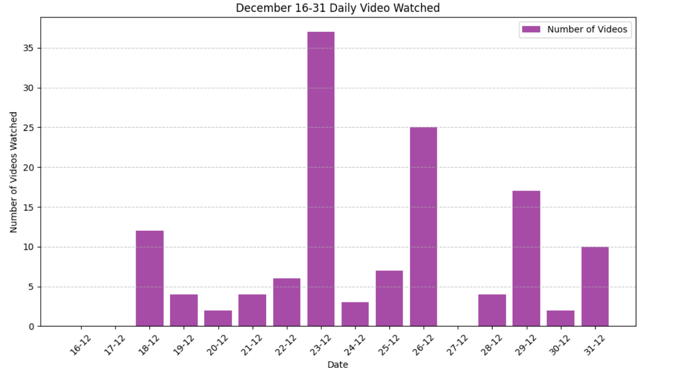
This is the third graph which is between 16th and 31st of December

Slide 11
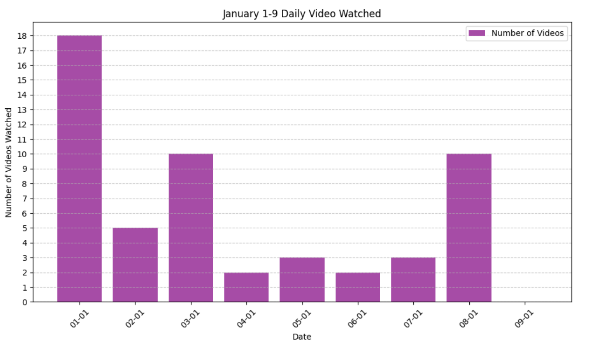
This is the fourth graph which is between 1st and 9th of January

Slide 12
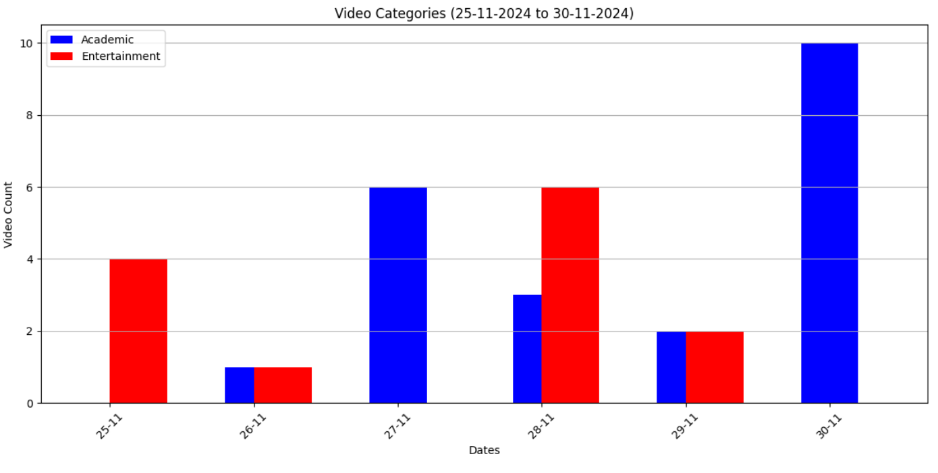
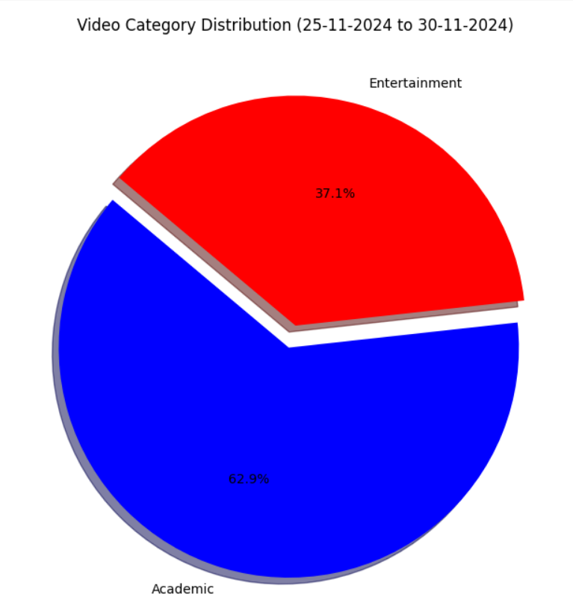
Categorization Of The Videos/ 1

Slide 13
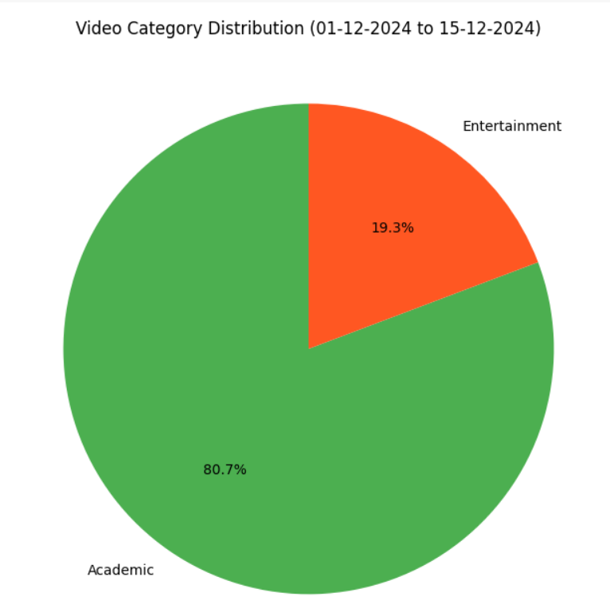
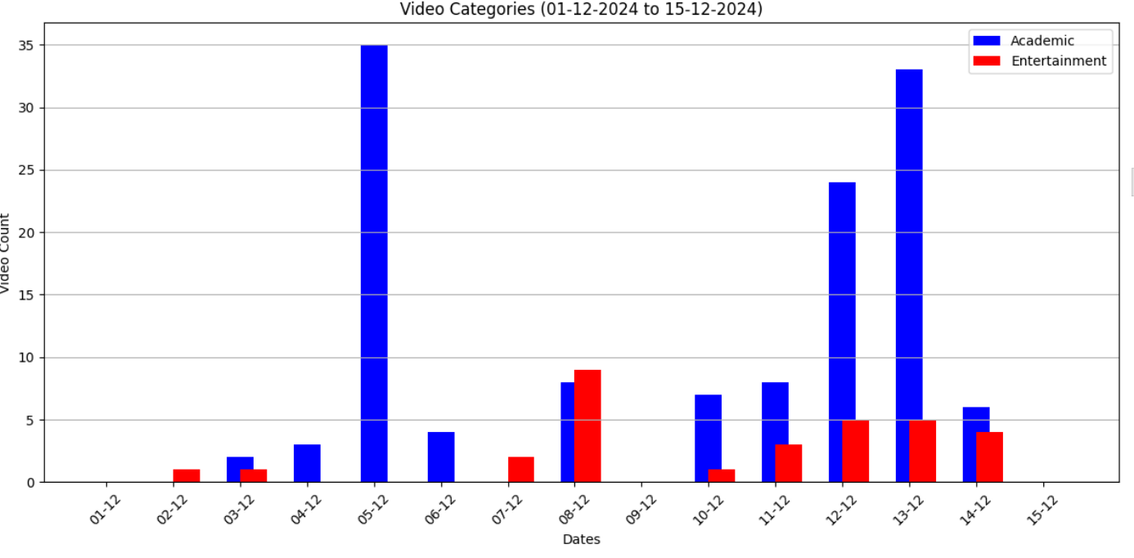
Categorization Of The Videos/ 2

Slide 14
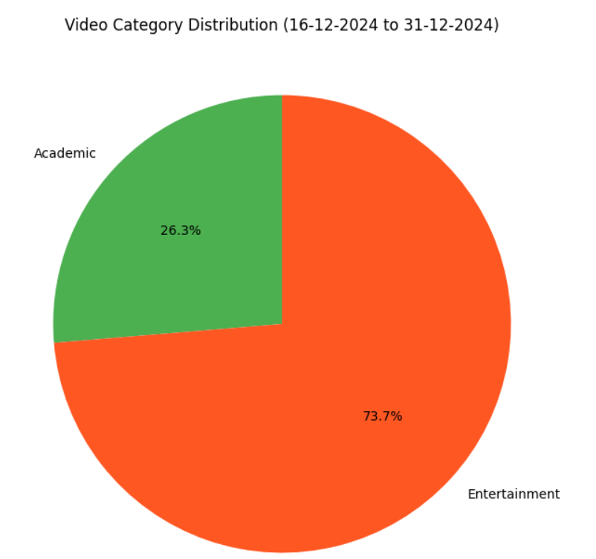
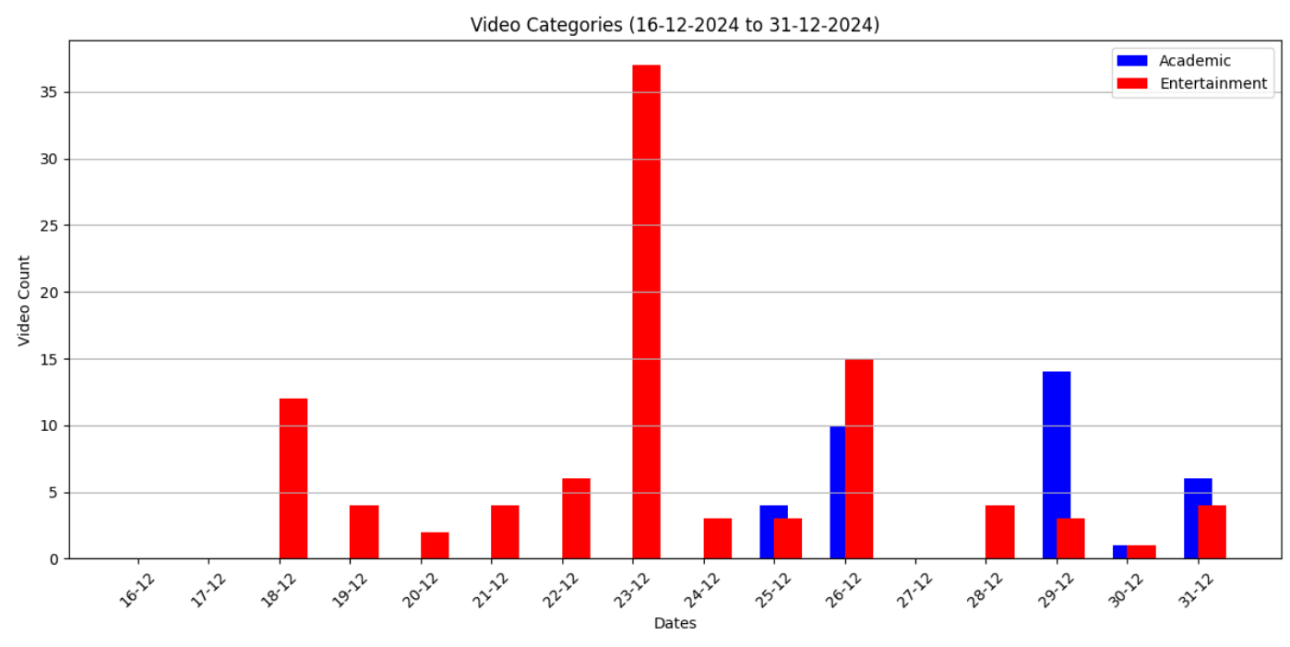
Categorization Of The Videos/ 3

Slide 15
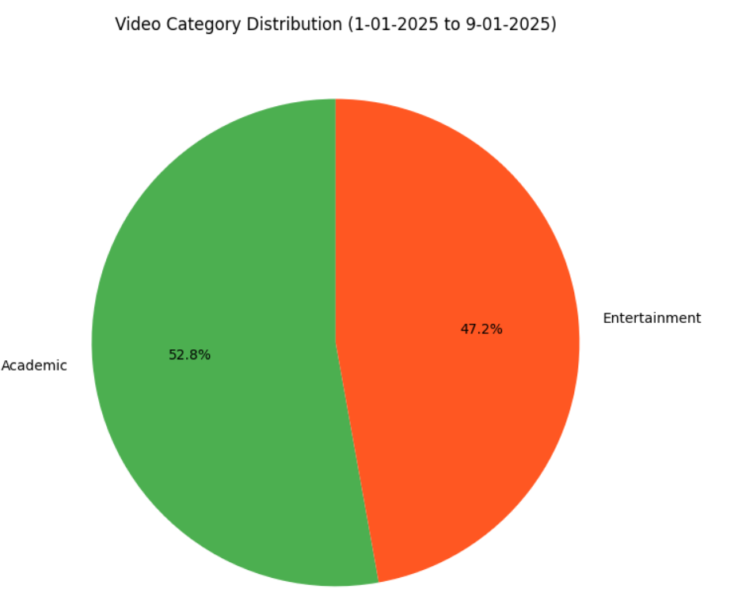
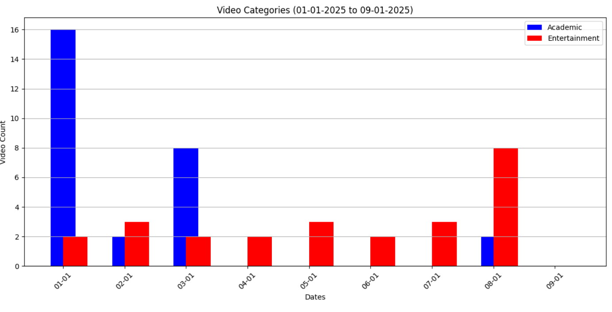
Categorization Of The Videos/ 4

Slide 16
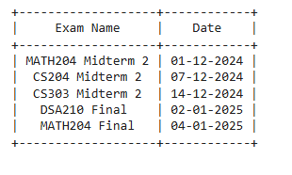
Exam Dates and how I decided the length of the exam periods.
To compare the categorization of the videos at the exam periods. I used the data from 1 and 2 days before the exam to gather more accurate data (Almost everyone studies more when there are 1-2 days left for the exam) so, it makes sense.
In the next step of the Project i build new graphs about the categorization of the videos on the exam times.

Slide 17
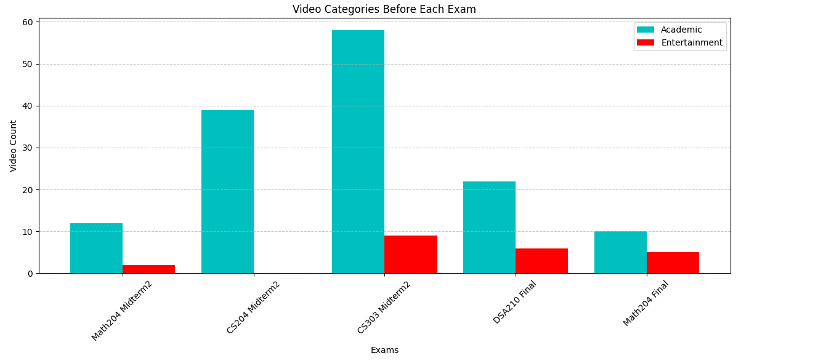

Slide 18
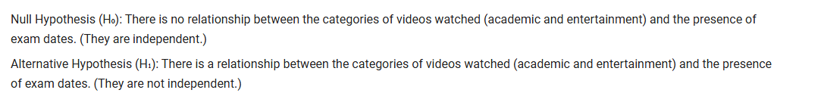
Findings and Result Part
After all the data’s and graphs I wanted to conduct a hypothesis test to determine whether the changes in video categories and the number of videos watched are related to exam periods, aiming to reach a concrete conclusion.

Slide 19
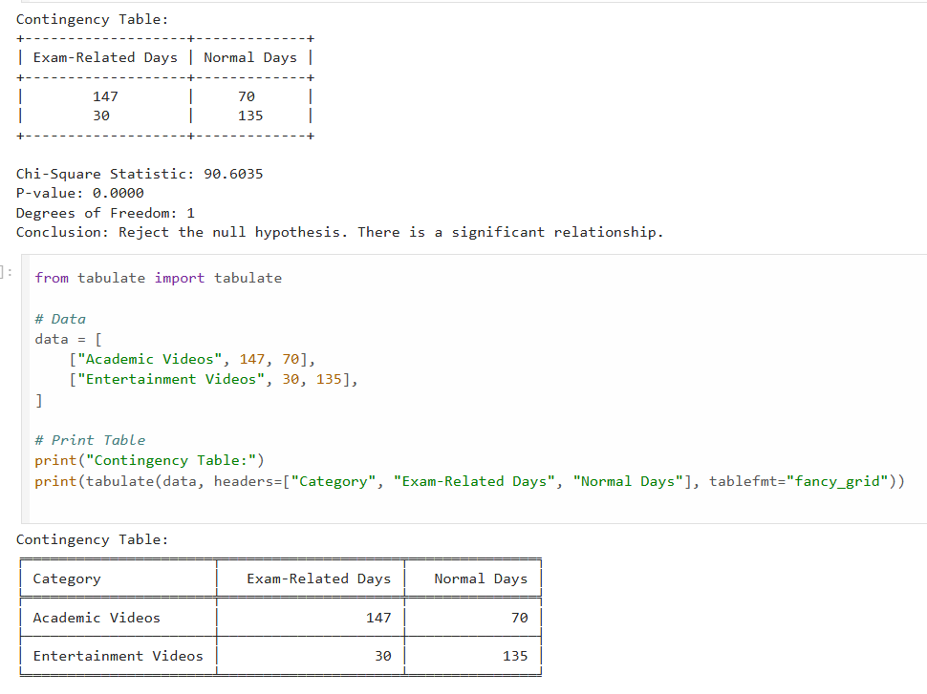
Result of the Hyphothesis Test

Slide 20
Findings Of The Project
1- According to the hypothesis test, we found that the changes in video categories and the number of videos watched are highly correlated with exam periods, which matched well with my initial assumptions.
2- Apart from this, I was honestly surprised to see that my total YouTube usage time increased during exam periods. As someone who usually studies from lecture slides, this finding helped me realize that as the semester progresses and the subjects become more challenging, I increasingly rely on video resources.

Slide 21
Limitations and future work
1- I used data from about 1,5 – 2 months of data so maybe this test can be done with a data with 1 or 2 years to get a better and more accurate results.
2- The biggest limitation was in categorizing the videos. The video titles in the .json dataset consisted of both Turkish and English videos, and in some cases, the titles were unrelated to the actual content of the videos. Additionally, the categorization process required keywords; if a keyword was present in the title, the video was assigned to a specific category. However, deciding on the appropriate keywords for hundreds of videos was quite challenging, leading to the possibility that some videos might have been missed or incorrectly categorized.

Slide 22
Future Work
In the future I would like to work on this Project with more data and more categories such as gaming, sports, academic, daily life, history,news, films and series. Thus, I would like to examine every single academic assignment like homeworks, projects.

Slide 23
THANK YOU FOR VIEWING MY PRESENTATION. HOPE YOU ENJOYED LOOKING AT MY PROJECT

